Slide 1
ER Desktop: How to Operate ‘Assurant’ tickets from Service Power
By: James Whang

Slide 2
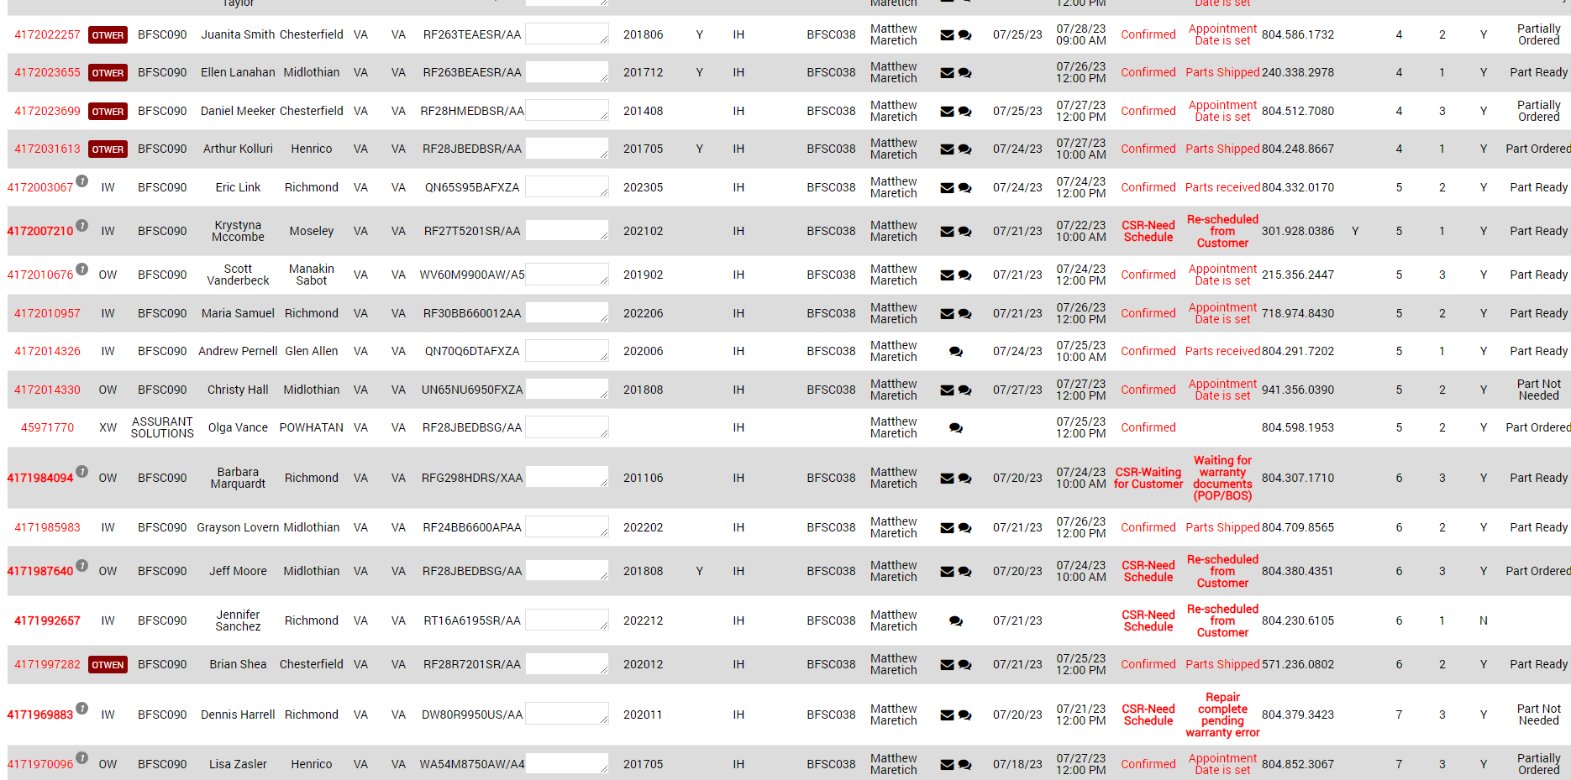
ER Mobile: Introducing Assurant Tickets
We are now getting tickets from Service Power. These tickets are referred to as Assurant tickets.
They have a different ticket number as compared to Samsung’s ‘417-’ ticket number

Slide 3
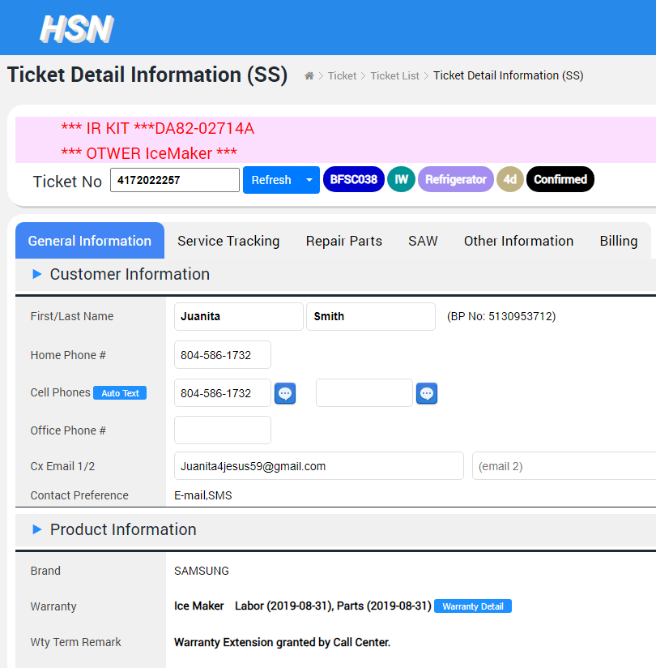
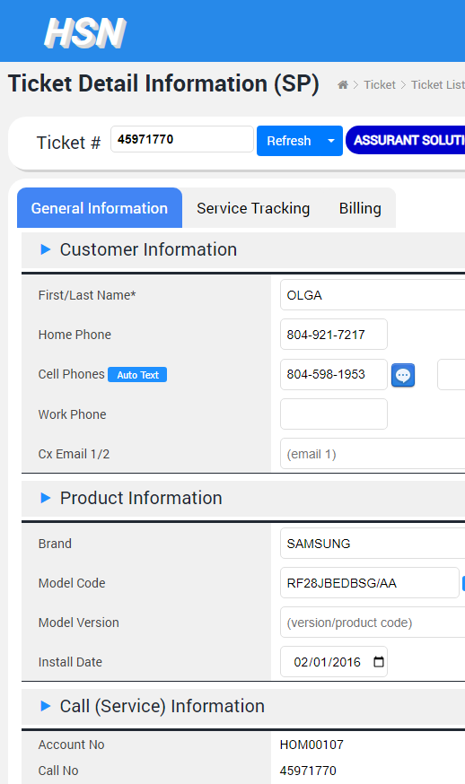
‘Samsung’ Ticket
‘Assurant’ Ticket
Notice the different Layout between the two types of Tickets.

Slide 4
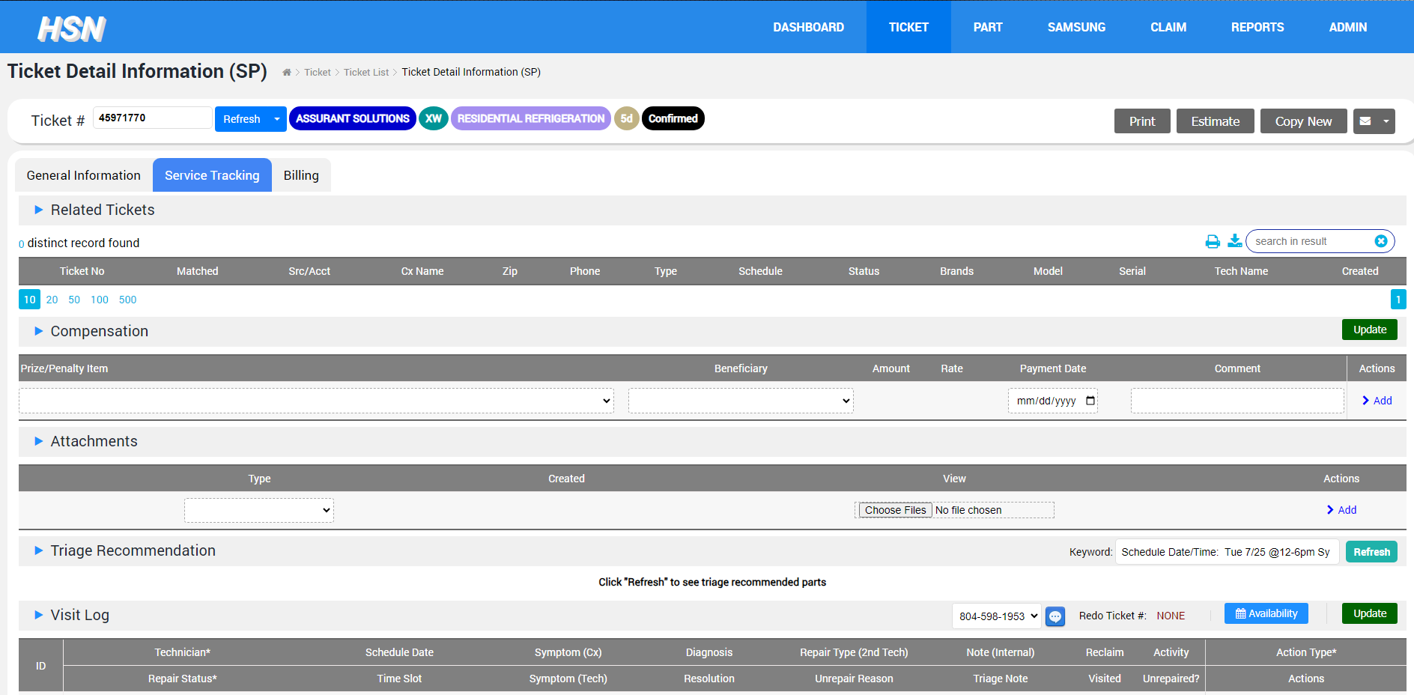
ER Mobile: How to Update tickets as a Technician
1. Navigate to the ‘Service Tracking’ tab
2. Scroll down to ‘Visit Log’
This is where you will update your ticket as a Technician.

Slide 5
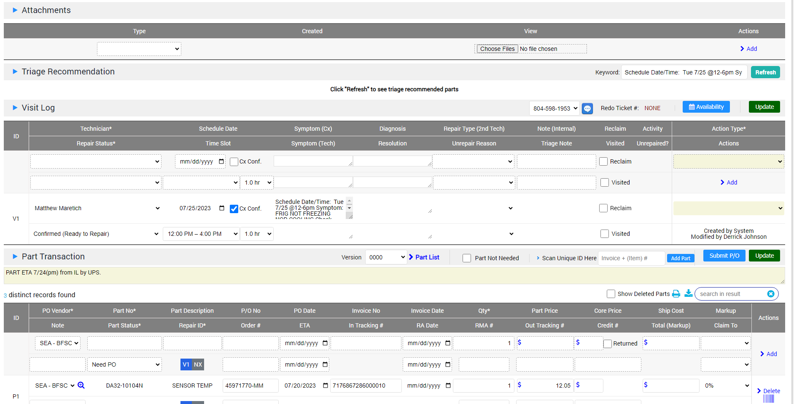
ER Mobile: How to Update tickets as a Technician
FYI: This refers to which number Visit you went out to service this Customer. If you are visiting the Customer for the first time, it will display as ‘V1.’ If you are visiting the Customer for the second time, it will display as ‘V2.’

Slide 6
ER Mobile: How to Update tickets as a Technician
1. To Complete your ticket, you can change the Repair Status here.
2. You MUST choose an Action Type here before Updating the ticket

Slide 7
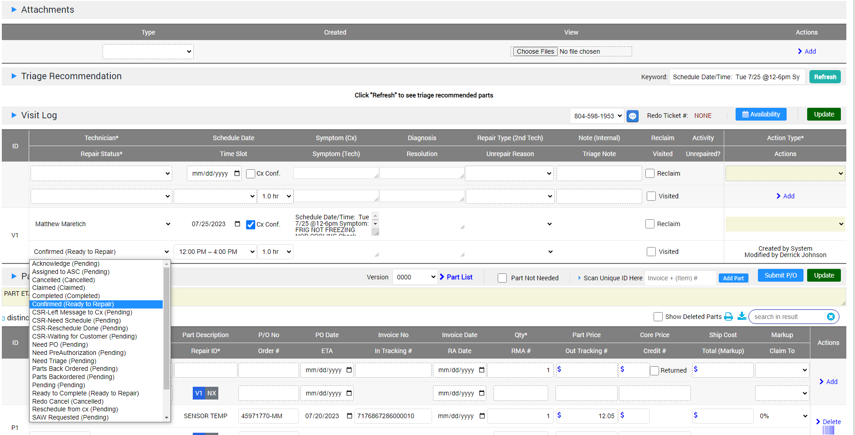
ER Mobile: How to Update tickets as a Technician
1. If you click on Repair Status, you can also select a variety of Pending reasons.

Slide 8
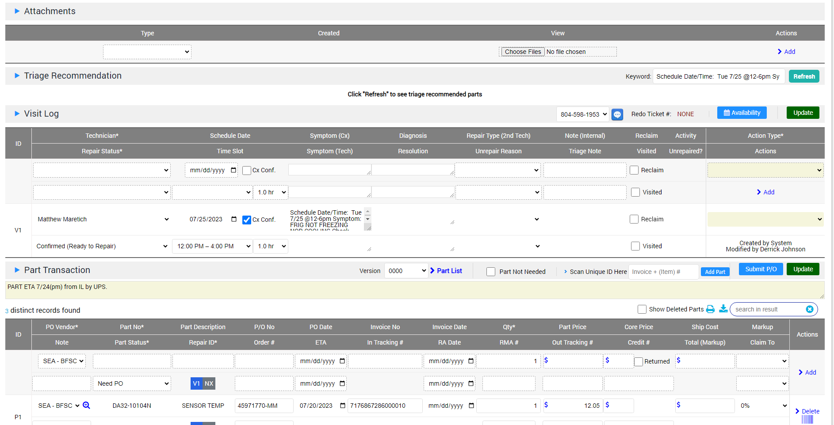
ER Mobile: How to Update tickets as a Technician
You can add notes by clicking on the Edit button located next to whichever note type you’re trying to add.
For example, if you’re trying to add notes about the Symptoms of the unit, you can click on the ‘Edit’ button next to ‘Symptom (Tech)’
3. If you’re done visiting the Customer, check mark the ‘Visited’ check box

Slide 9
ER Mobile: How to Update tickets as a Technician
To attach pictures to the ticket, click on ‘Choose Files’ under the Attachments tab and then select what type of attachment you are uploading.
Then select Add to upload

Slide 10
ER Mobile: How to Update tickets as a Technician
To attach pictures to the ticket, click on ‘Choose Files’ under the Attachments tab and then select what type of attachment you are uploading.
Then select Add to upload

Slide 11
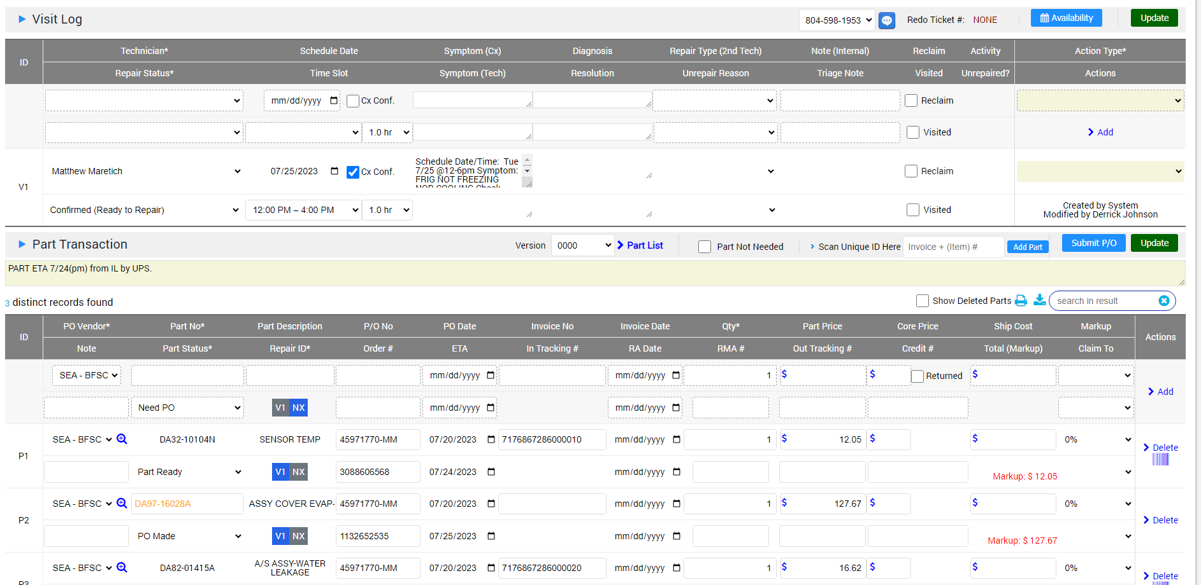
ER Mobile: How to Update tickets as a Technician
Scroll down to Part Transaction to see the list of parts reserved for this Ticket.
2. You can type notes in this text box (DESKTOP VERSION ONLY)
3. You can type notes into the text box under ‘PO vendor’ for a specific part.

Slide 12
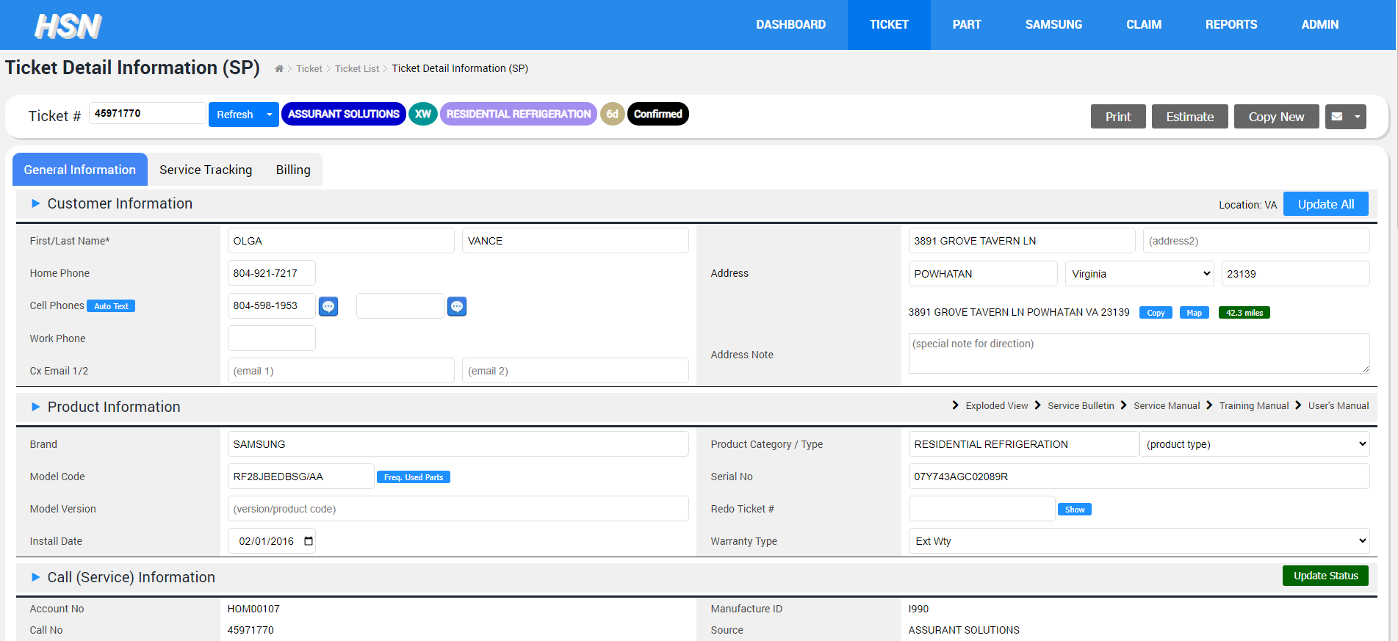
ER Mobile: How to Update tickets as a Technician
There’s one more additional way to make notes on a ticket.
Navigate to ‘General Information’

Slide 13
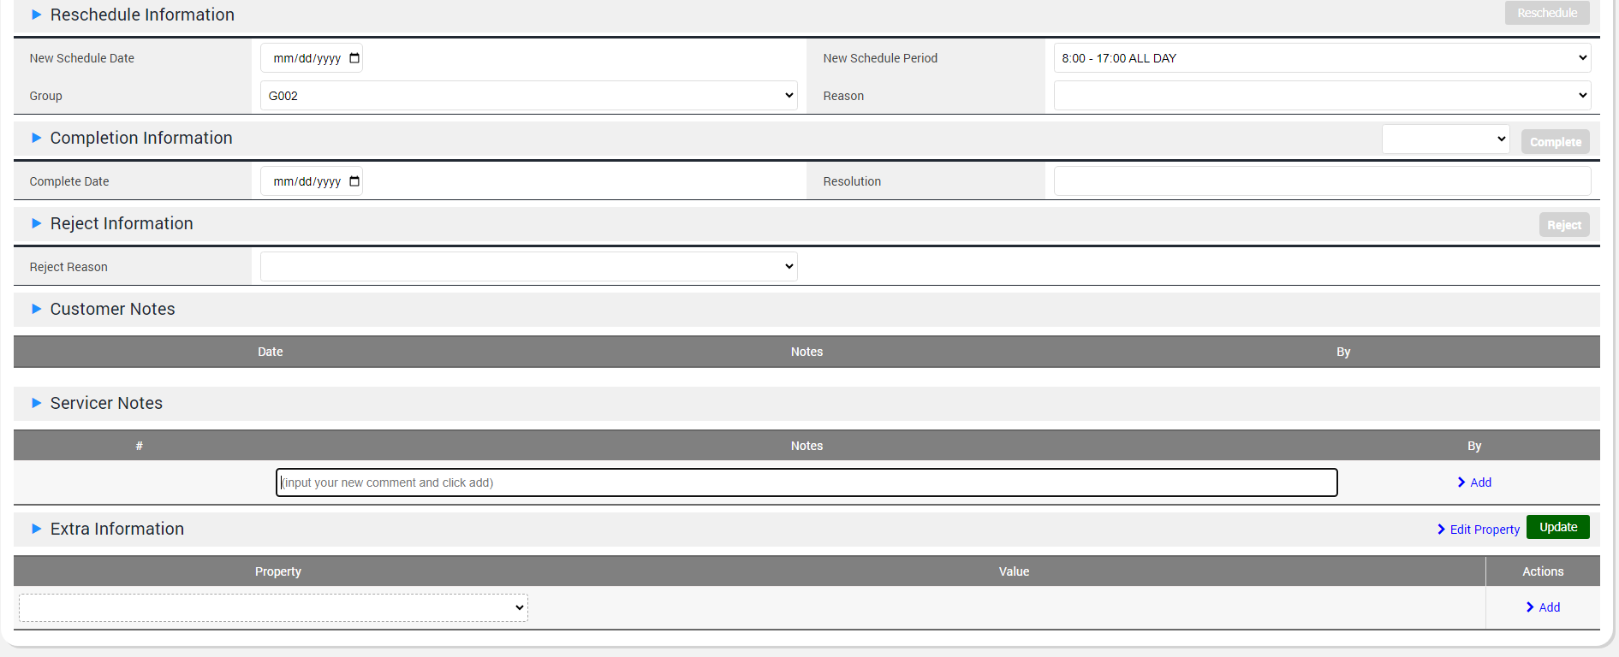
ER Mobile: How to Update tickets as a Technician
Look for ‘Servicer Notes’
Type in your notes here and the click on ‘Add’ to upload

